Slide 1
Emotion Detection from text using NLP
By :
K. Kavya

Slide 2
OUTLINE
ABSTRACT
INTRODUCTION
EXISTING SYSTEM
REQUIREMENTS SPECIFICATIONS
CONCLUSION

Slide 3
ABSTRACT
Analyze and identify the emotions expressed in textual data
Feature extraction, sentiment
lexicons, machine learning algorithms
Data preprocessing, model training, and evaluation
Probabilistic model

Slide 4
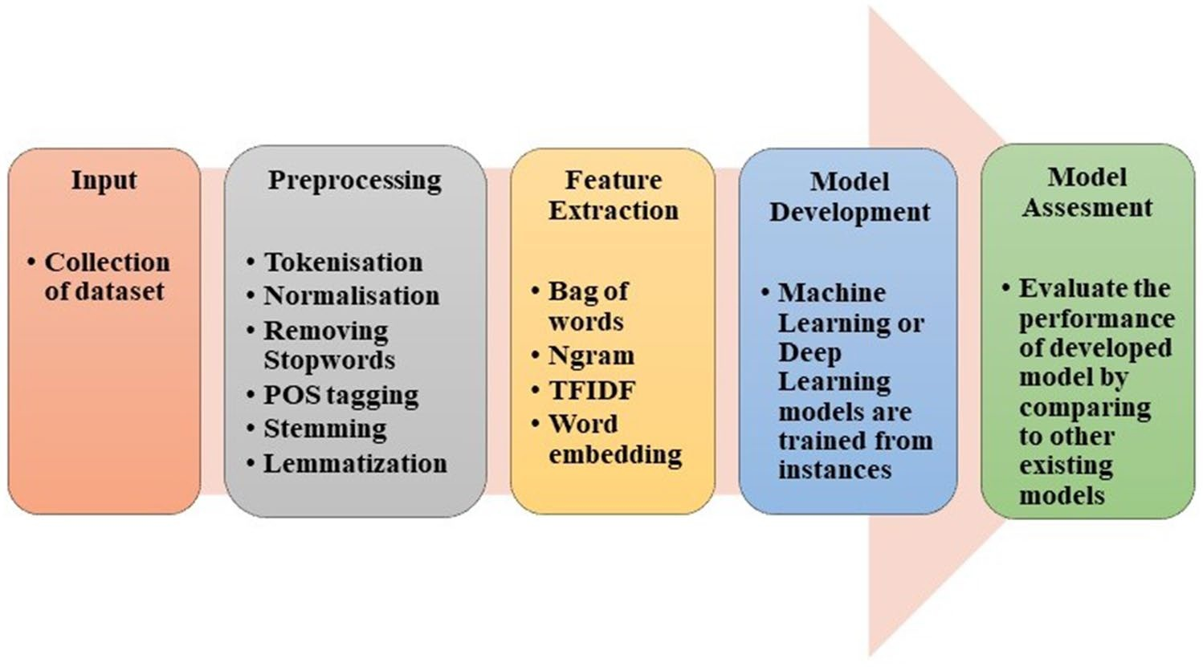
INTRODUCTION

Slide 5
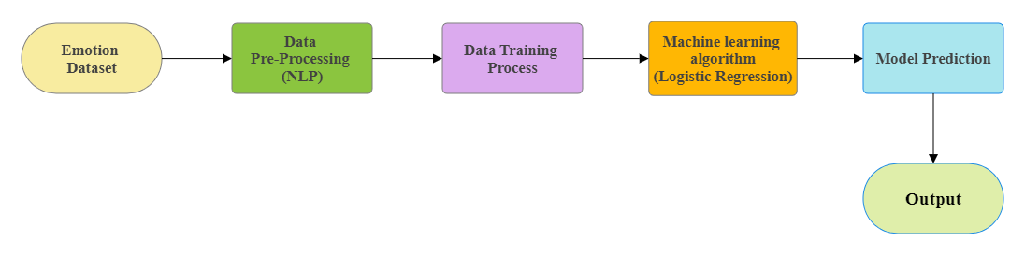
Existing system
Re

Slide 6
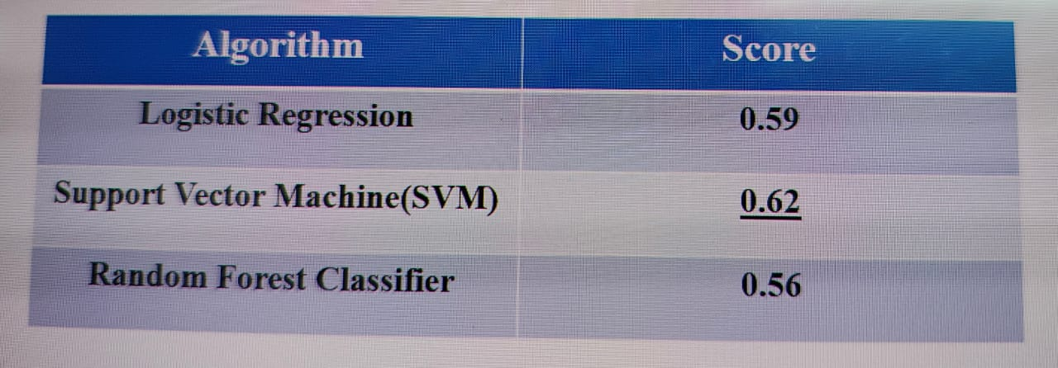
Training Algorithm Accuracy Scores

Slide 7
Requirements SPECIFICATIONS
SOFTWARE REQUIREMENTS:
Operating system: Windows XP/7/10/11/Linux
Coding Language: Python
Jupyter Note Book

Slide 8
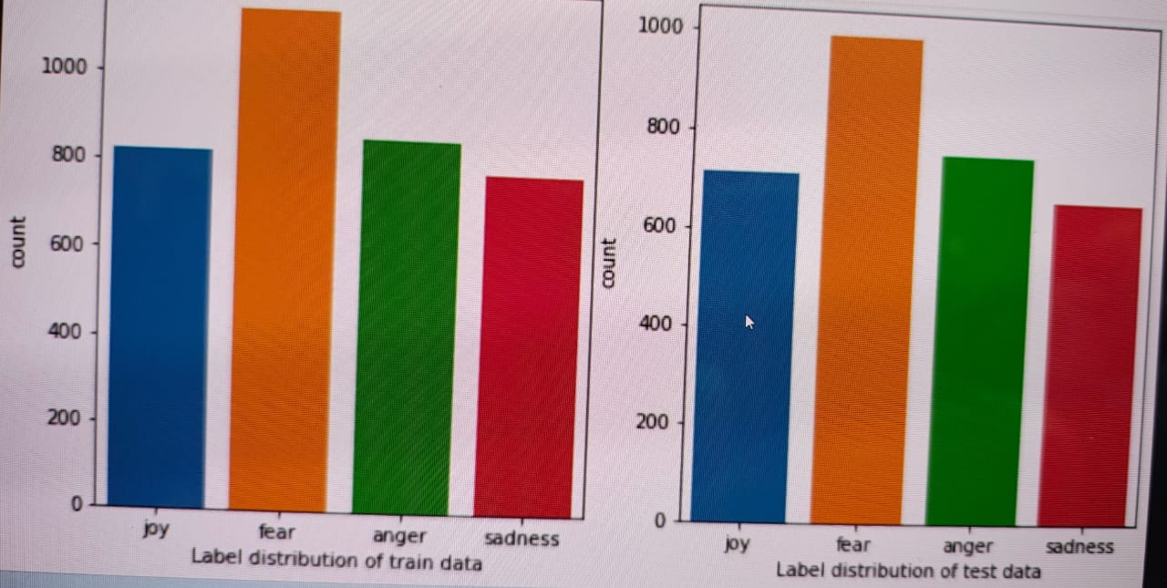

Slide 9
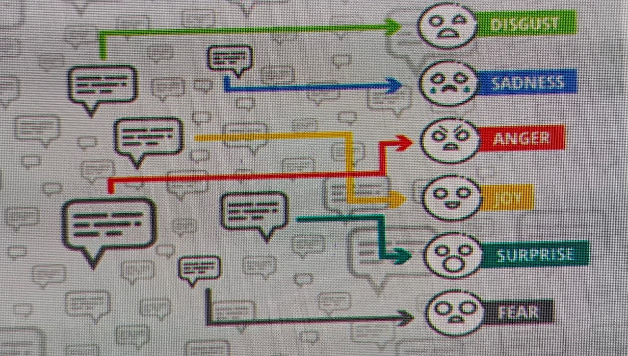
Offers valuable opportunities for understanding and analyzing human emotions expressed in textual data.
CONCLUSION
Various applications such as sentiment analysis, social media monitoring, customer feedback analysis, and mental health assessment.
Researchers can gain valuable insights into public opinion, customer sentiment, and user experiences.

Slide 10


